Slide 1


Group 3.5
FINAL STAGE
UofCMingle

Slide 2
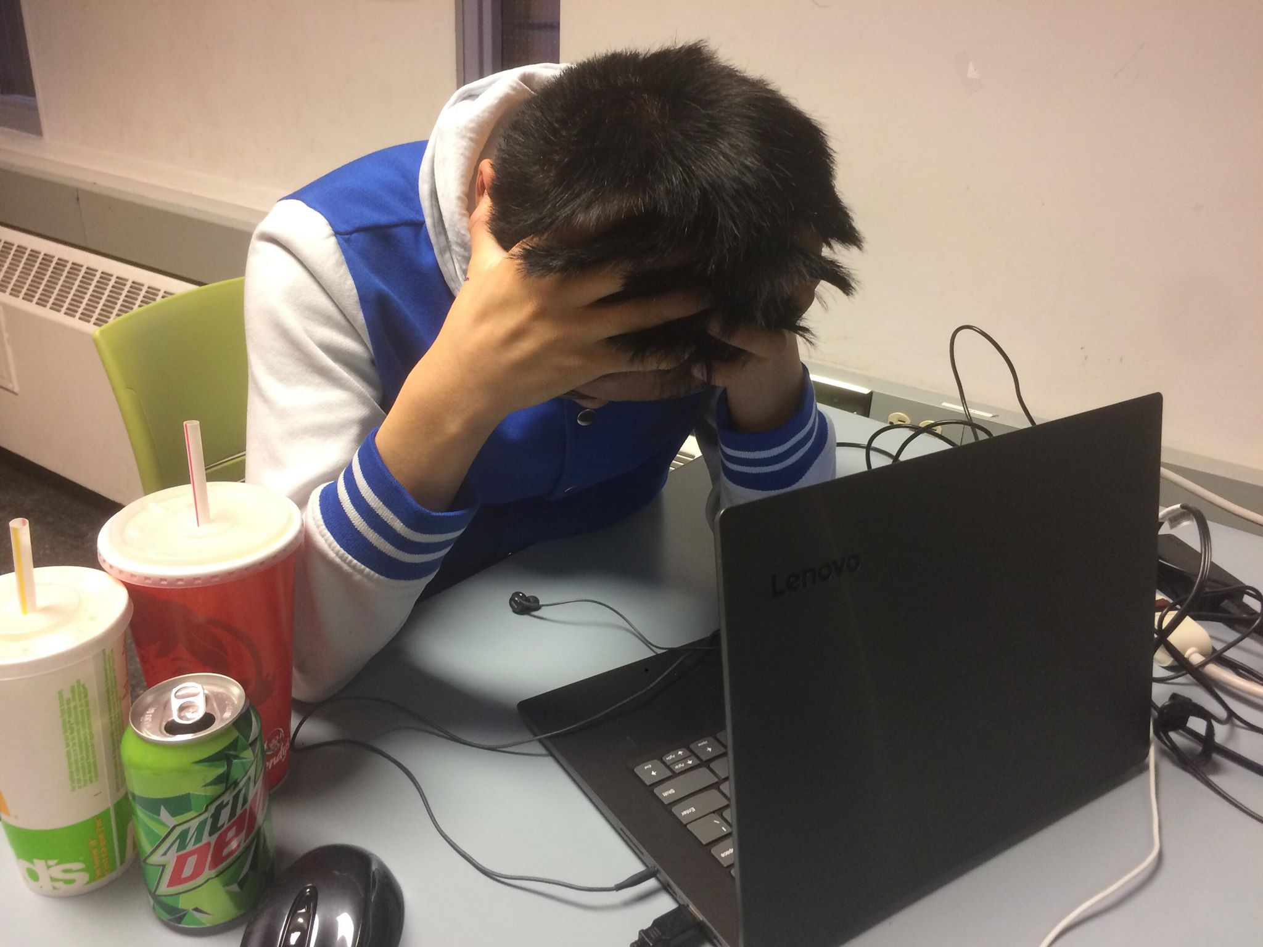
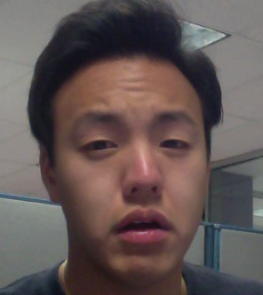
Design Problem
Many students around UofC find themselves to be quite inactive socially, due to fact that there are not many easy ways to get involved in clubs around campus. Group 3.5’s idea is to create an accessible platform for all students to find clubs that would suit them.
UofCMingle is a new platform designed to help you find the clubs that are right for you. Through efficient searching, organized calendars, and a clean feed of news, UofcCMingle gives great ease in bringing students into a more social university life.
How do I find the right clubs!?

Slide 3


Who are we designing for?
I want to join a club that suits my tastes!
End users
Students and club executives - at for the primary users of the app; students who would use the app in order to discover new clubs and events or students who are already joined many clubs and would want an easy way to navigate through them. And club executives who would use the app to allow new or old club members to find more information about the club and events surrounding it that are happening on campus.
No worries I gotchu fam i’ll make one!

Slide 4

Stakeholders
University admin staff - As the administrative head of the university they would want such an app to adhere to the rules of the university while also providing students the opportunity to discover and engage in finding events for new or current clubs that they have joined. In order to do so the university staff may require the club application to have certain constraints or implementations to have more relativity ease of use for students.
Before you make that app of yours, let’s check with the University rules. Aight looks good!

Slide 5
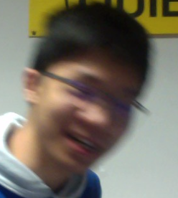

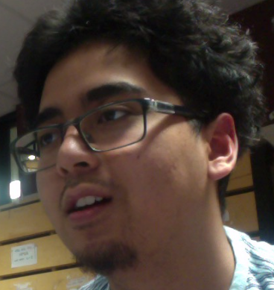

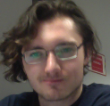
User Research
Prior to designing our prototype we had two primary researching methods to help determine the overall goal of what our application should achieve:
Interviews
Secondary Research.
Let’s gather some information amigos...

Slide 6

Interviews
For the interviews we decided to select our primary user group, other students, to conduct this. By doing so made it feel more natural discussing their opinions on the matter rather then giving them a survey. From these interviews the main points we discovered was that although most of those who we interviewed were interested in joining more clubs they had problems with club and events outside of club week and would want a much more easier search method of doing so. As such we took these considerations in mind to design an app that would emphasize finding clubs and finding the events related to those clubs with relatively ease of search.
Yea, I think if there was an app for clubs I would definitely be more social!
Interesting, thanks for the input!

Slide 7

A game with a point system for clubs?? What a great idea!
Secondary Research
Looking up information for the secondary research lead to many previous articles and topics about other apps of similar design, many of the interesting points was that many apps favored one that involved more engagement from the users, such as gamifying the app, an idea that unfortunately did not have enough time to fully develop for our prototype. However the insight still provided a lot of information to help flesh out our prototype.

Slide 8
Major Design Decisions

Slide 9
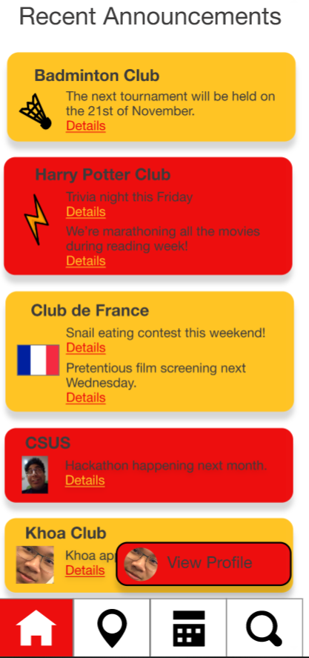
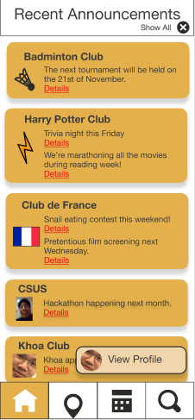
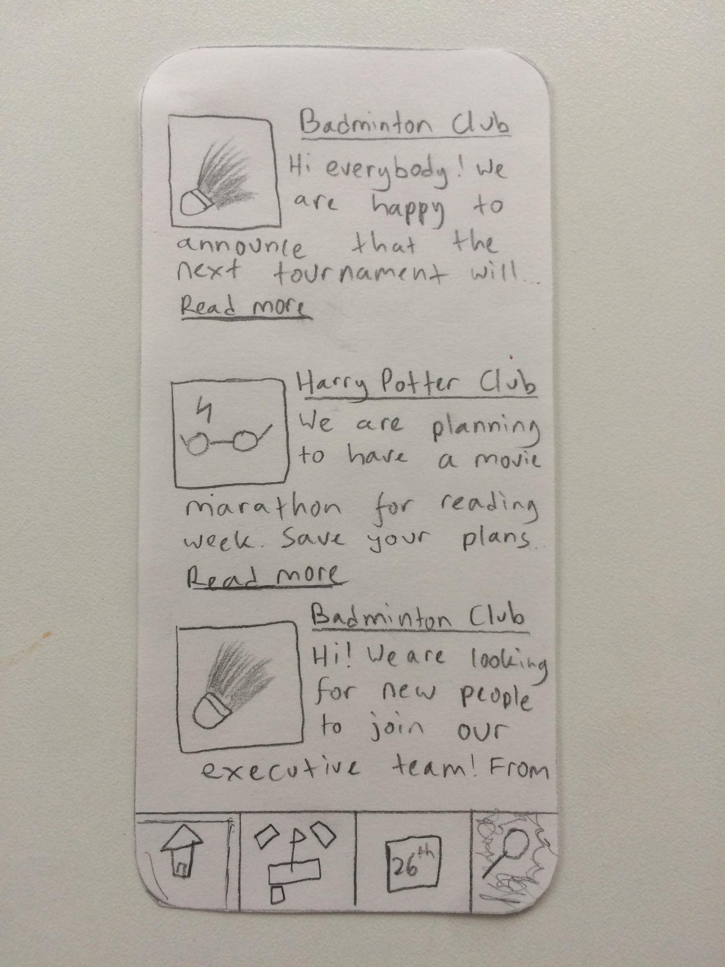
Feature 1: Home Feed

Slide 10
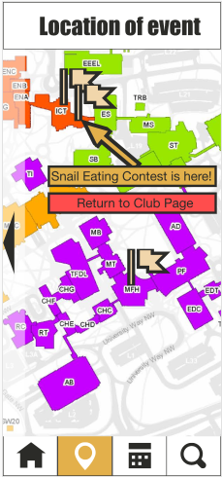
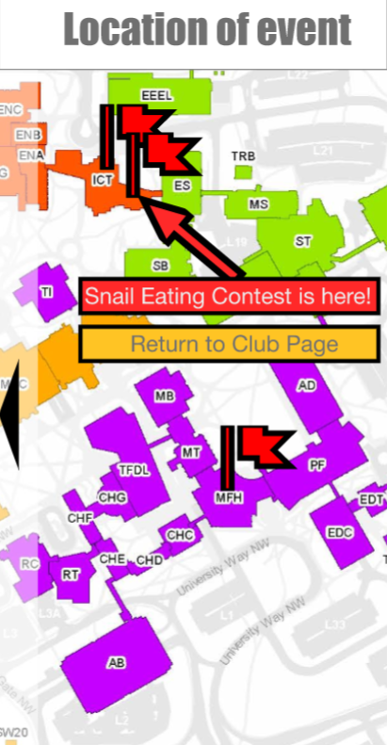
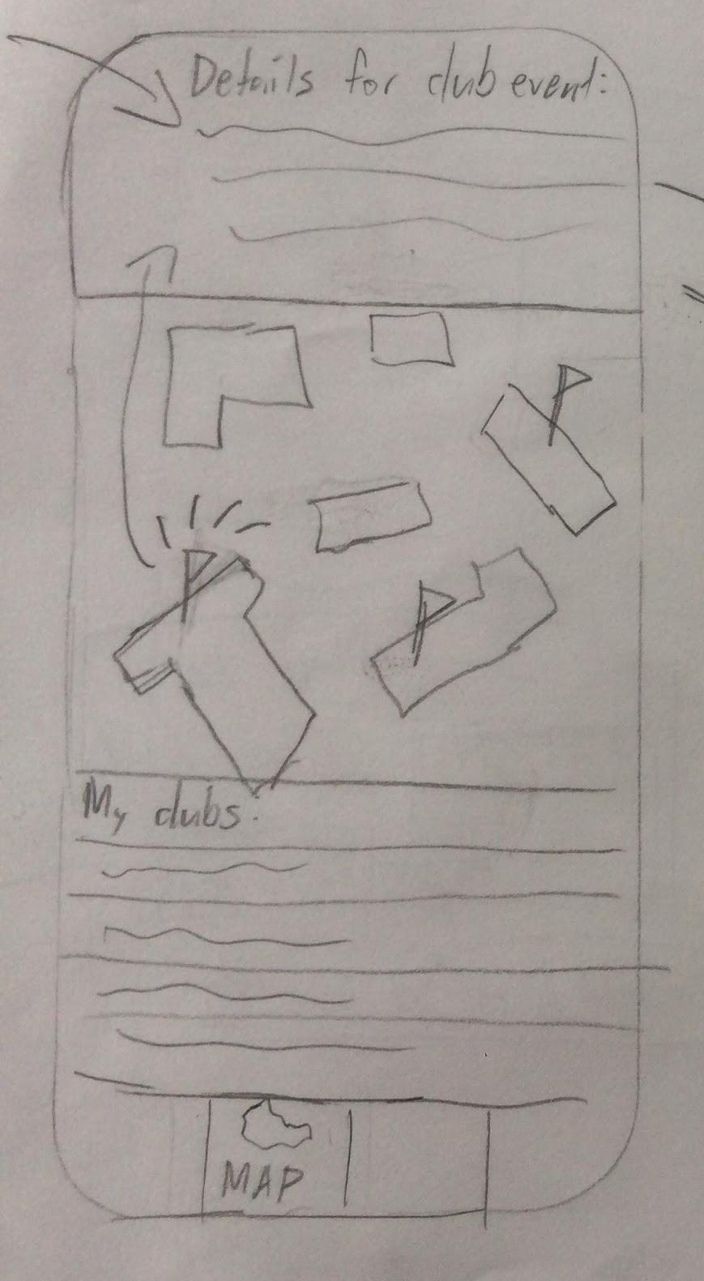
Feature 2: Interactive Map

Slide 11
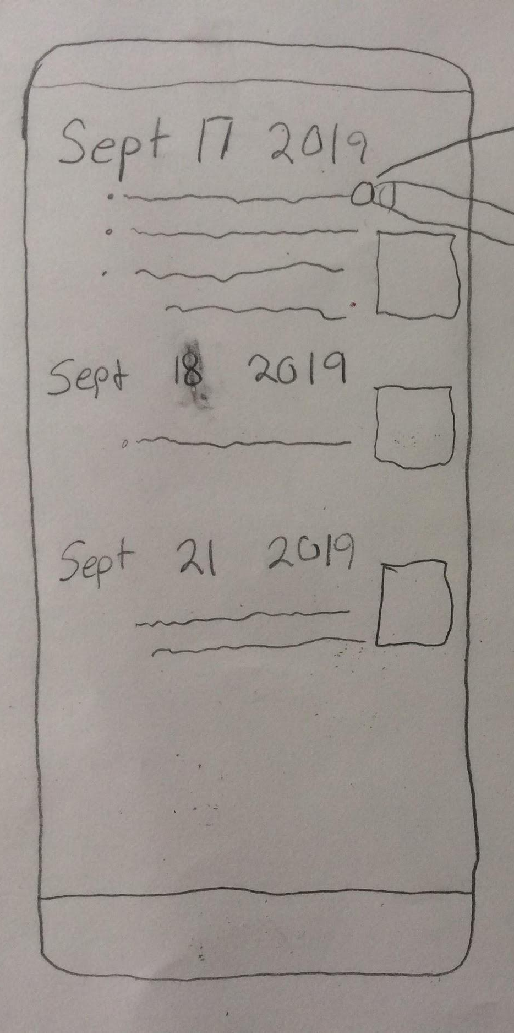
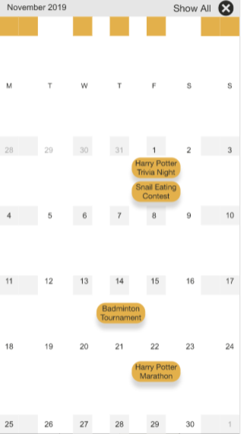
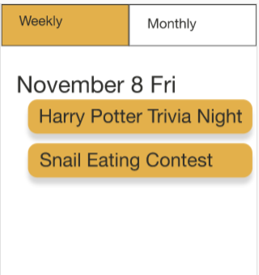
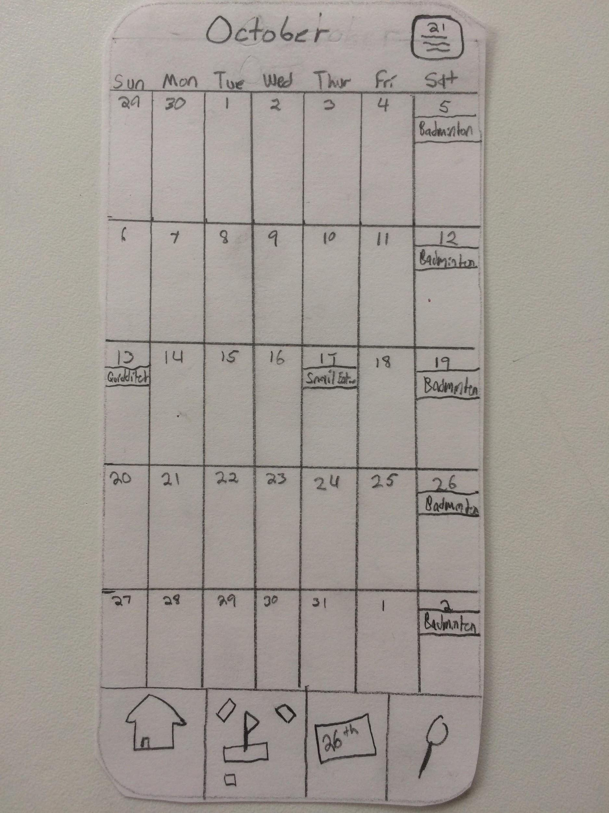
Feature 3: Monthly/Weekly View

Slide 12
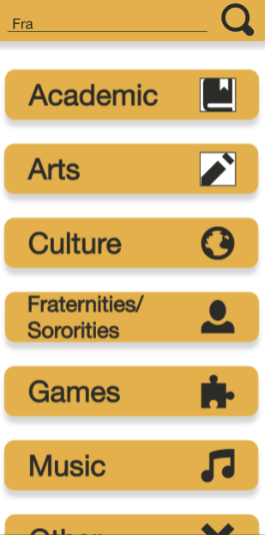
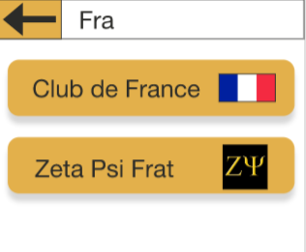
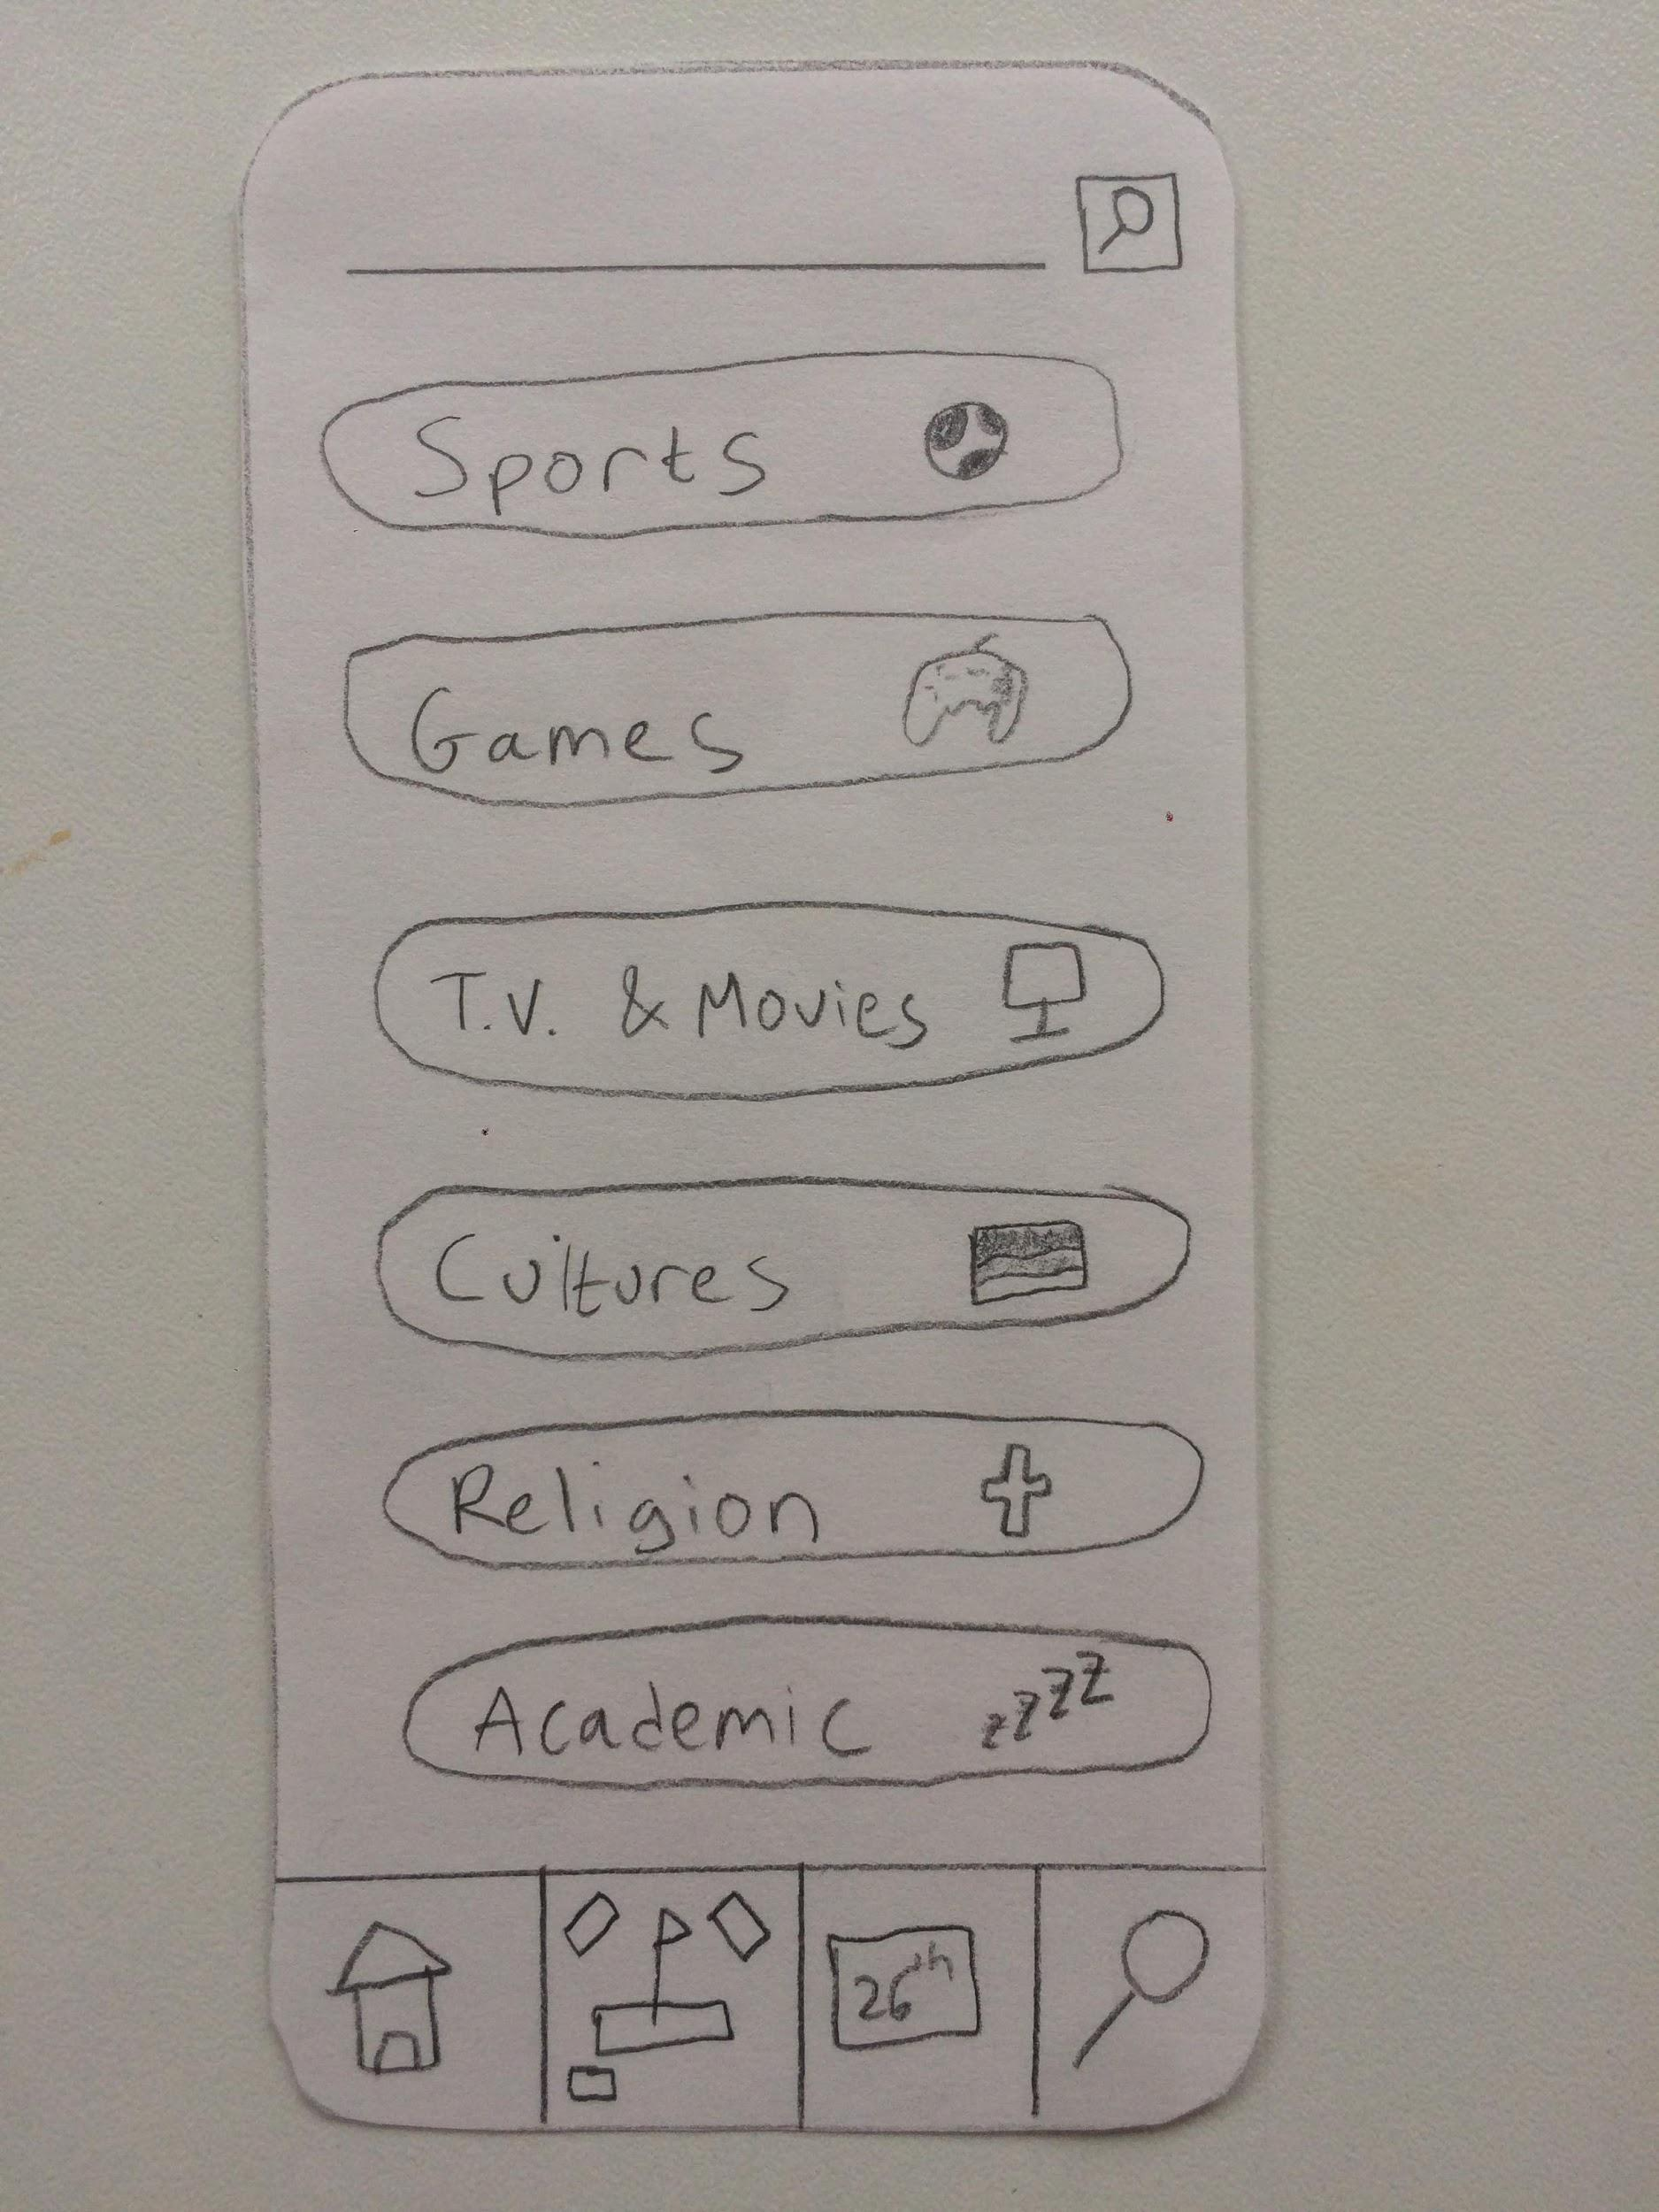
Feature 4: Categorical/Keyword Search

Slide 13
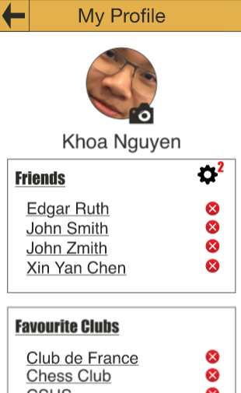
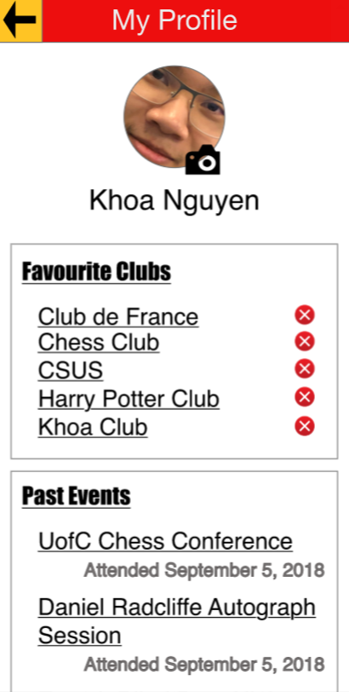
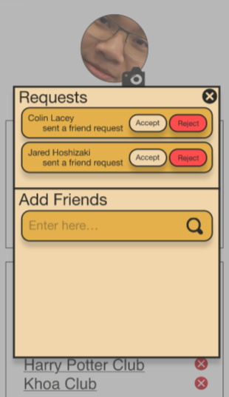
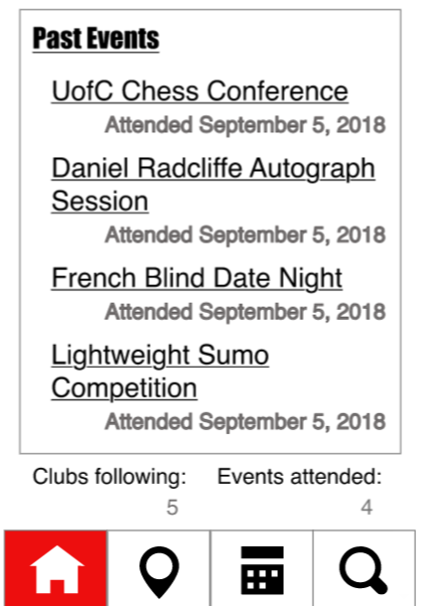
Feature 5: Personal Profile/ Friend System

Slide 14


Halted Design Ideas
The biggest idea that we decided to throw out was a gamification of our app. Similar to what was known as LevelUp last year, we wanted to create a point reward system to make people feel more motivated to try and go out to more things. We felt that there would be no need for that anymore, since not everyone would want to have to worry about a point system, but instead would just want to go out and experience meeting new people, which that in itself gives enough reward to them.

Slide 15


Heuristic Evaluation Results and Implications
Our application’s heuristic evaluation was conducted by group 34 and from this evaluation our group discovered the following:
Testing time!

Slide 16

The functionality of the app worked well to show the user where they are and what they did, as well as holding very consistent standards that many other apps do (visually with the choice of symbols used and in the general layout and locations of the buttons)
However the inconsistency lays in how to navigate throughout the app, either require to return to the main 4 sections in order to access information in them or difficulty in going back a step.
Where am I??

Slide 17

The overall color and design of the app could also be workshopped a bit better, using the University of Calgary colors felt off and shape of the text boxes felt sharp when compared to other app’s.
All in all the app was easy to pick up and learn with adjustments needed to better suit a user with more experience with app as well as making it more visually appealing.
This design is kinda ugly...

Slide 18
Final Prototype Demonstration
https://xd.adobe.com/view/a930b2c8-3550-49a5-669f-84076bd5ef58-df01/?fbclid=IwAR1FAW833ksgzIqIQ_FTJ2lRSFU3-8hKBj1LOyS5b0rf0UMTCQUbWp6FeoE

